Slide 1

Generative AI
Théâtre D'opéra Spatial, an image generated with Midjourney (public domain image)
Won the 2022 Colorado State Fair's annual fine art competition in the photomanipulation category, sparking endless controversy

Slide 2
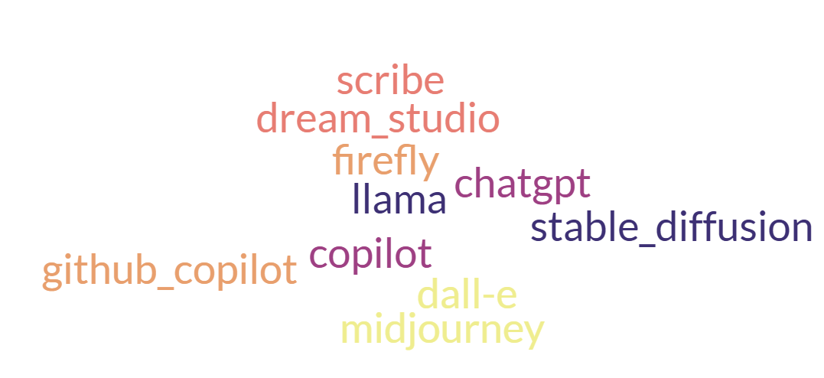
Generative AI
Technologies that create or generate data.
Peril and promise
Code generation
Text generation
Image generation
Text→ image generation?

Slide 3
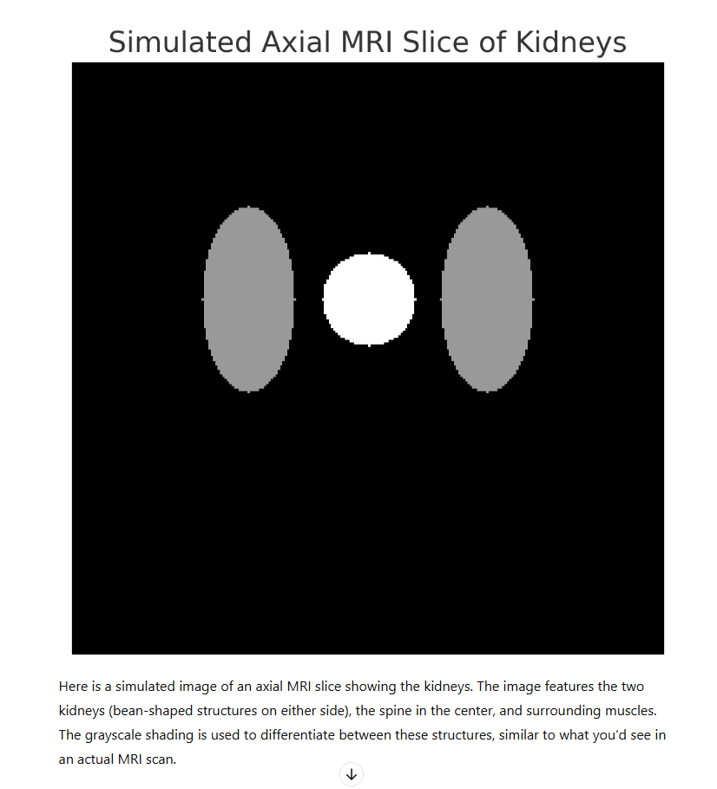
Generative AI
Is this picture incorrect?
Can we prompt a better one?

Slide 4
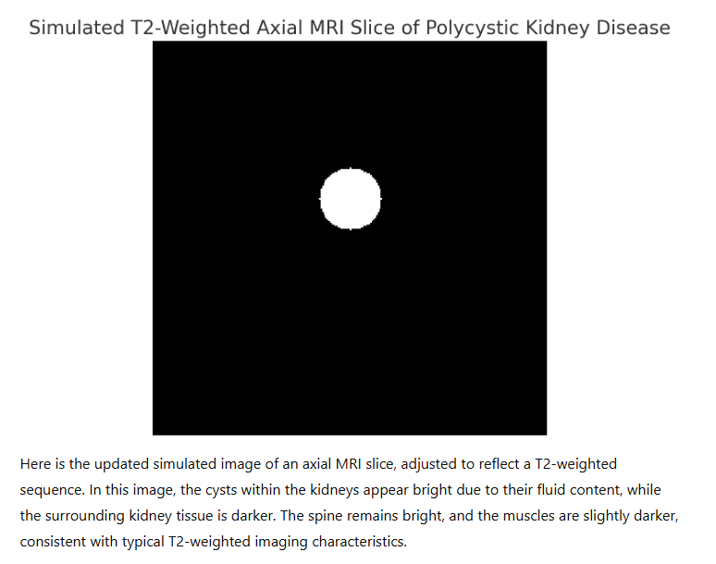
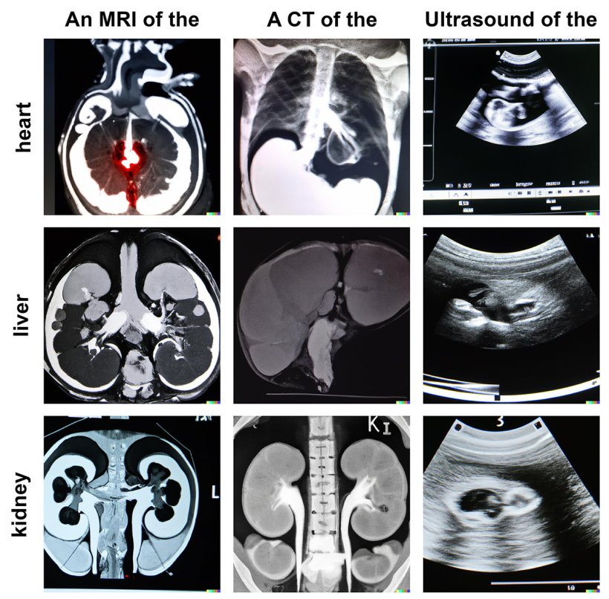
Generative AI
Examples of text-to-image–generated anatomical structures in CT, MRI, and ultrasound images created with DALL-E 2.
Image source: Adams et al., Journal of Medical Internet Research 2023 (CC BY 4.0)

Slide 5
Generative AI
MONAI is open and was trained on UKBiobank data and other legit data
https://monai.io/
You lost me at pip install…but thankfully there is a conda-forge
But you need data and gigabytes of it:
Suggestions: medicaldecathalon.com, kaggle.com, public datasets

Slide 6

Generative AI
Safety first!
Never upload non-anonymized sensitive patient data outside your secure servers
Avoid using sensitive patient data with online tools (e.g., chatGPT, integrated tools like co-pilot, MS Office)
Be mindful of internet connectivity with your code editors and tools
Prefer systems that operate locally (on your machine or hospital servers)
Acknowledge that tools may generate erroneous information (hallucinations)
Don’t assume code generated by a large language model (LLM) lacks potential bugs or harmful code
Address intellectual property and ethical considerations when utilizing generative AI models
Document model usage thoroughly in academic work, detailing versions and exact applications
Recognize that the training corpus of such models may introduce biases

Slide 7
Generative AI
Challenge/Exercise: Assessing the Risks of Local Model Deployment
Can you identify a few risks associated with running a model entirely on your machine?
And now a TOP 8 list to be effective once we are safe

Slide 8

Generative AI
Be effective
Ensure accuracy in spelling and grammar to avoid misdirection
Provide clear and detailed prompts
Explain the context or goal (e.g., “helping my son… can you explain it in a specific way?”)
Try different wordings to refine results

Slide 9

Generative AI
Be effective
5. Fact-check thoroughly
First, ask the tool to fact-check its output
Then, verify using search engines and experts
Never fully trust references or facts generated by an LLM, seek human-generated content for confirmation
6. Clearly indicate if you need a particular format (e.g., bullet points, square images)
7. Use prompts like “you are a Python expert” or “you are an expert pathologist” to guide the tool
8. For more accurate outputs, fine-tune foundation models with your specific data

